Slide 1
Design of a FRP running blade
Gabriele Decortes
Fabio Marchi
Emanuele Nicolò Pizzo

Slide 2
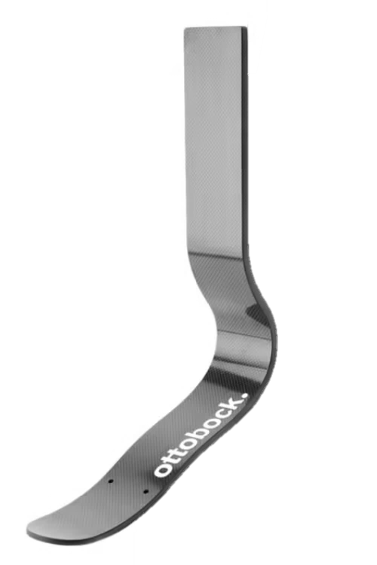
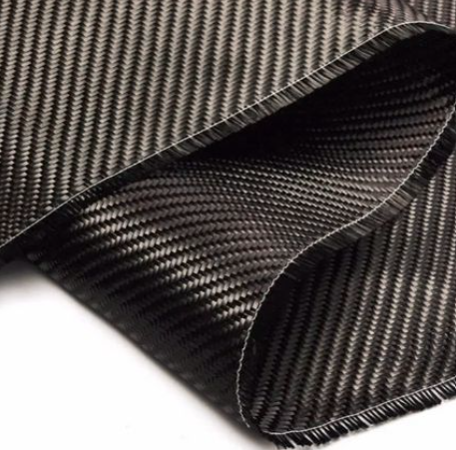
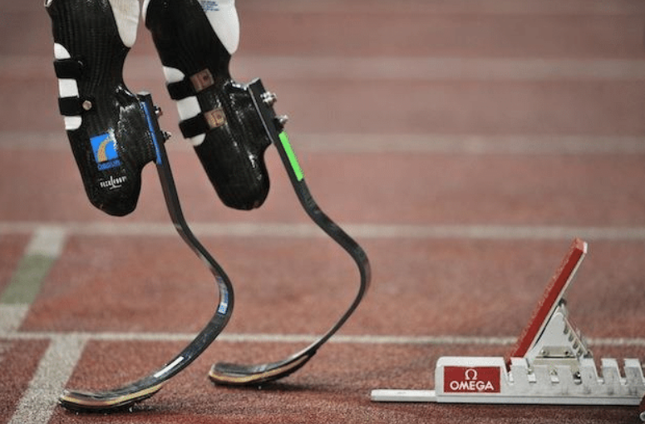
Project overview
FRP
Running blade
Stacking sequence
Weight
Short distance running
Long and high jumping

Slide 3
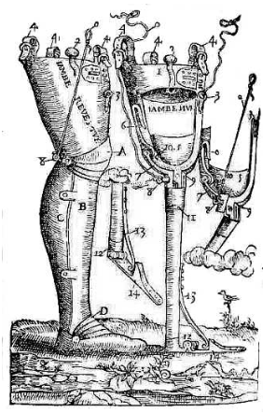
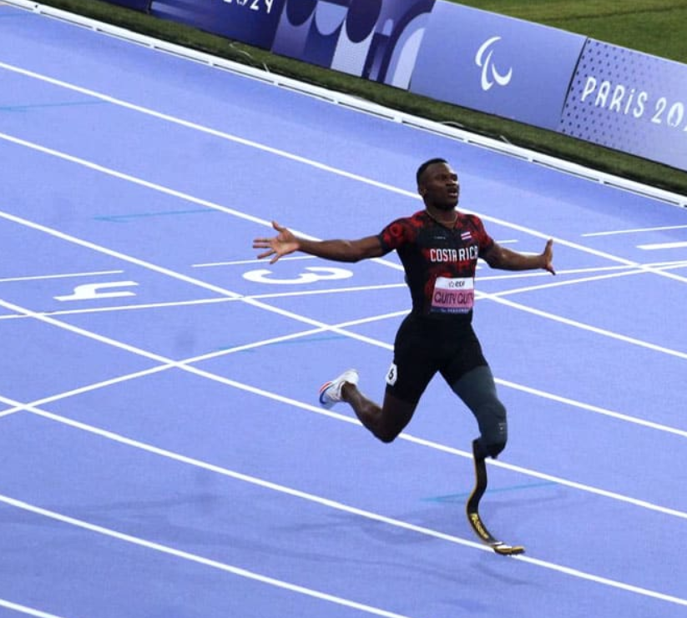
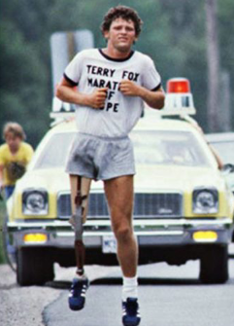
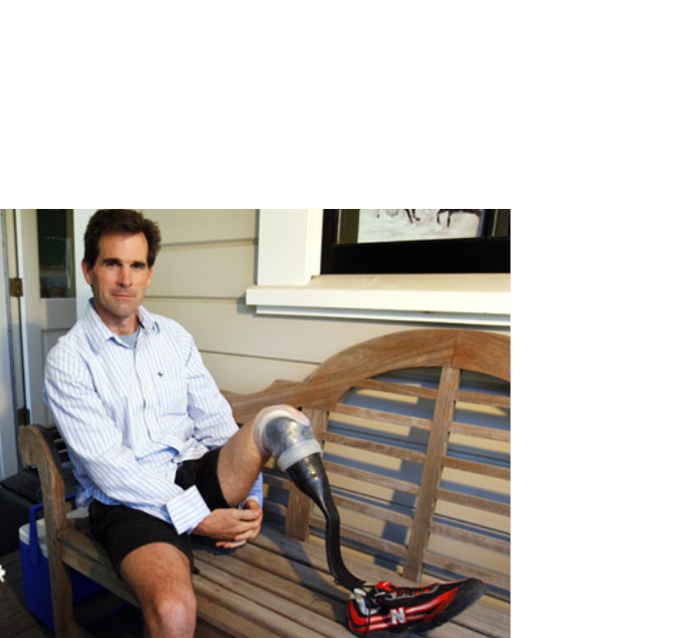
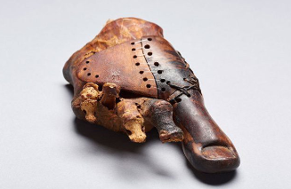
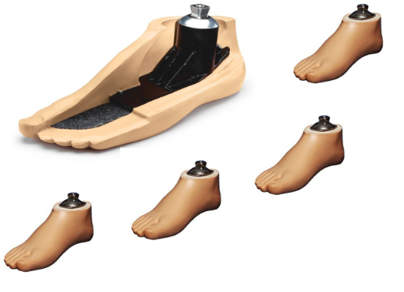
History of lower limb prostheses
Egyptians and Romans
Wars and conflicts
Terry Fox and Van Phillips
Renaissance
SACH foot
Today

Slide 4
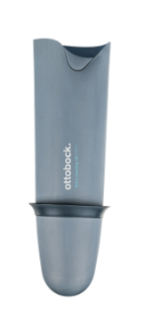
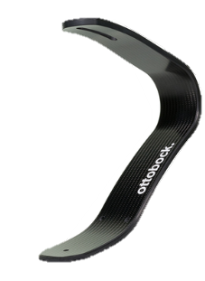
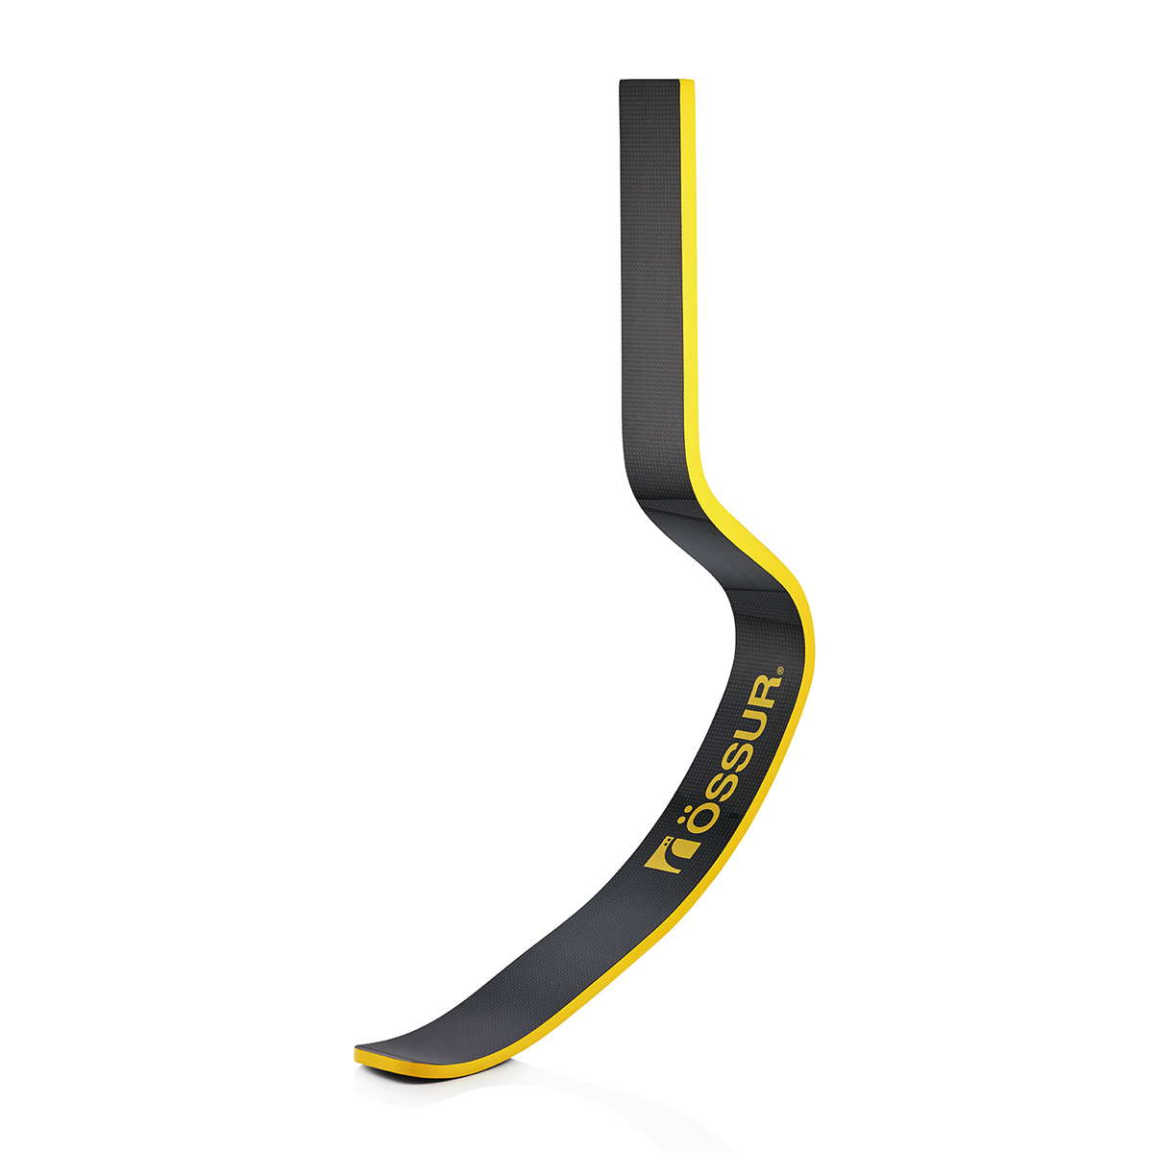
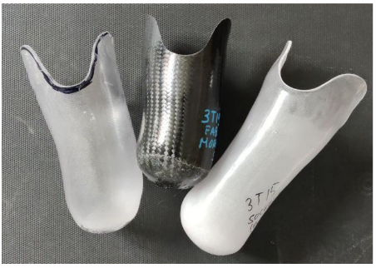
Composition of RSPs
Liner
Socket
Blade
Avoids friction and movements
Silicon or polyurethane
Allows control of the prosthesis
Rigid or flexible
Acts as a spring to transmit energy
C-shaped or J-shaped

Slide 5
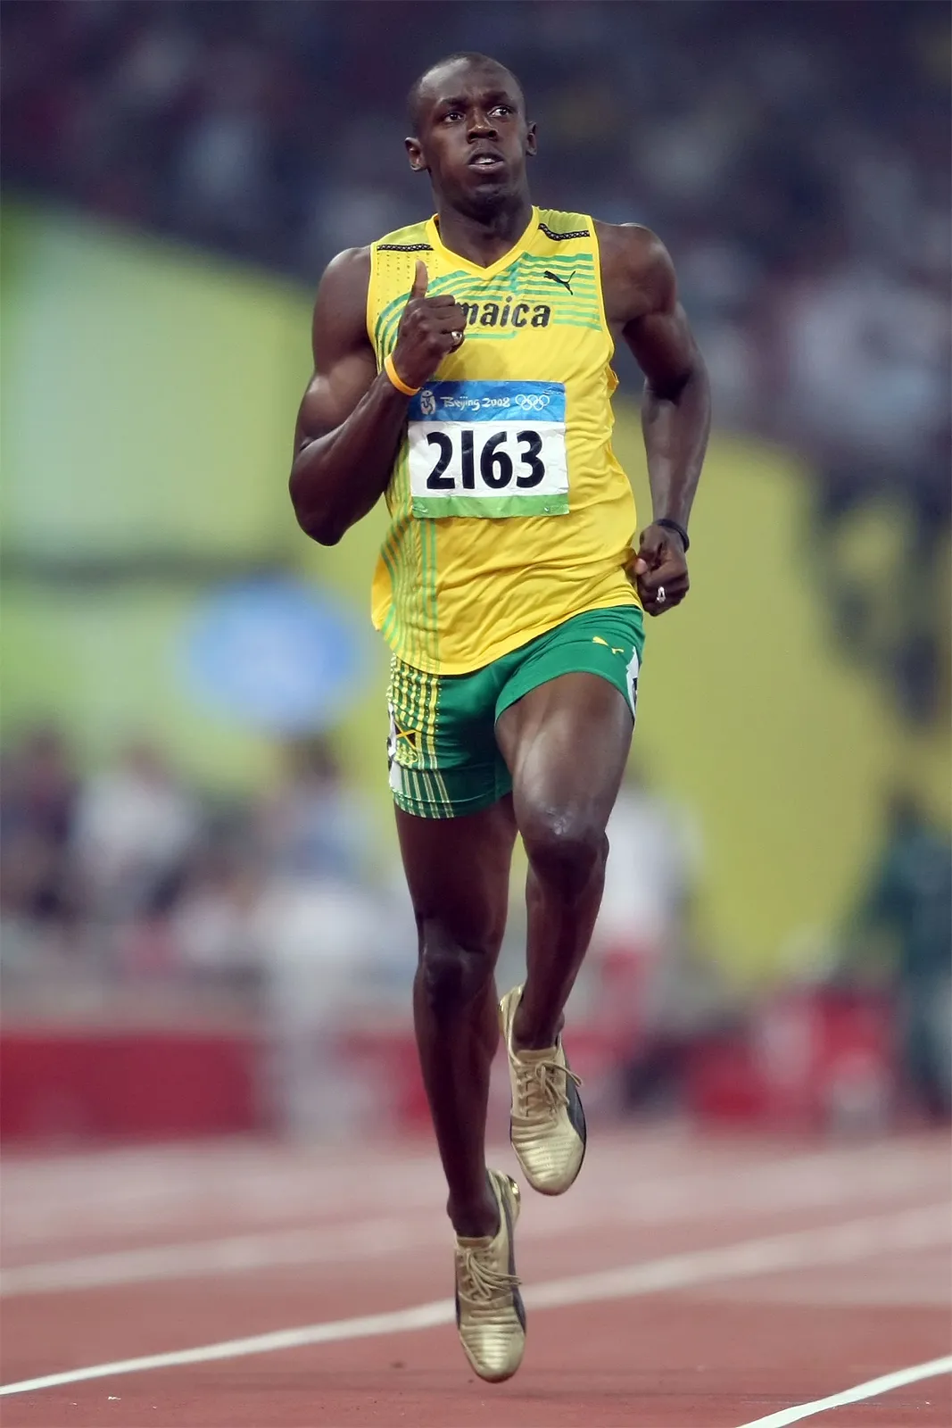
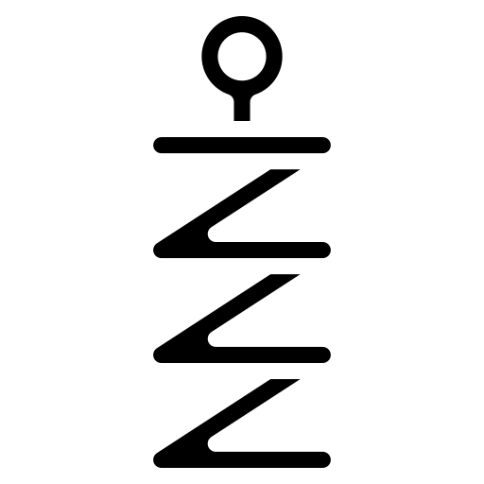
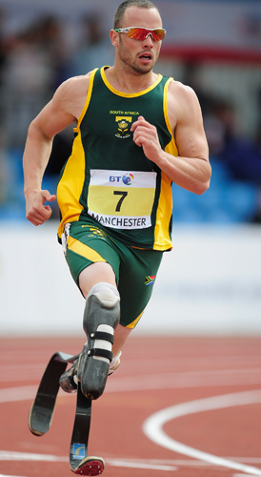
Composition of RSPs
Spring-mass system
Energy efficiency < 240%
Energy efficiency < 90%

Slide 6
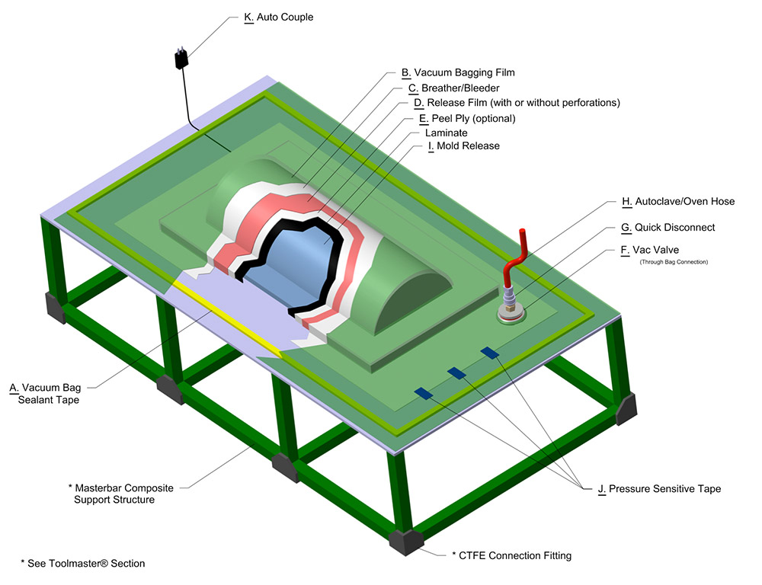
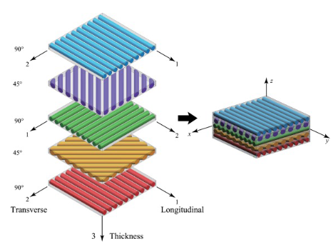
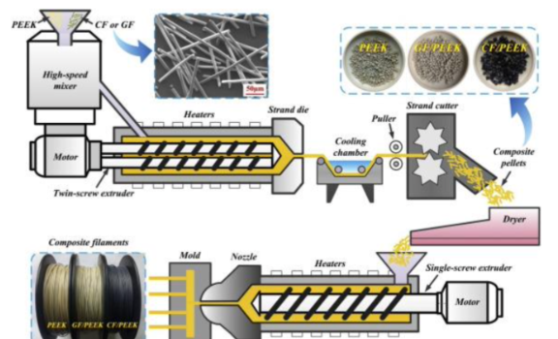
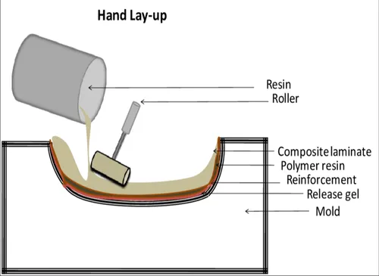
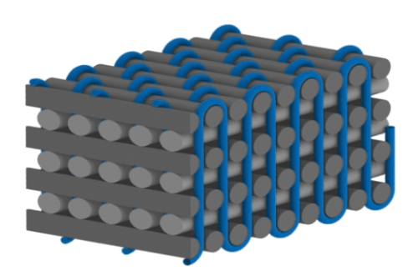
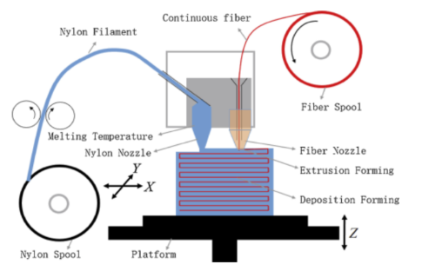
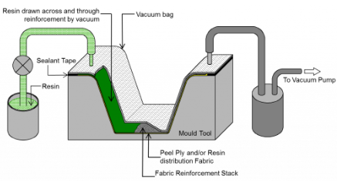
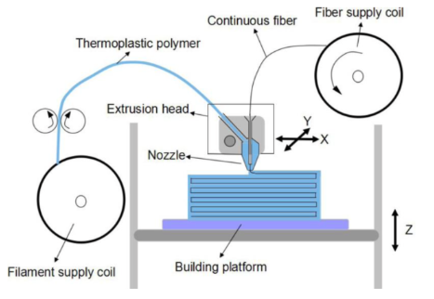
Manufacturing technology
Preliminary work
Classical methods
2D laminates
3D woven
Hand lay-up
Prepreg Vacuum-Bagging
Resin transfer moulding
Innovative methods
Prior incorporation
Incorporation in the nozzle
Incorporation on the component

Slide 7
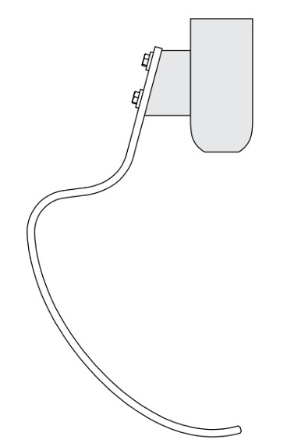
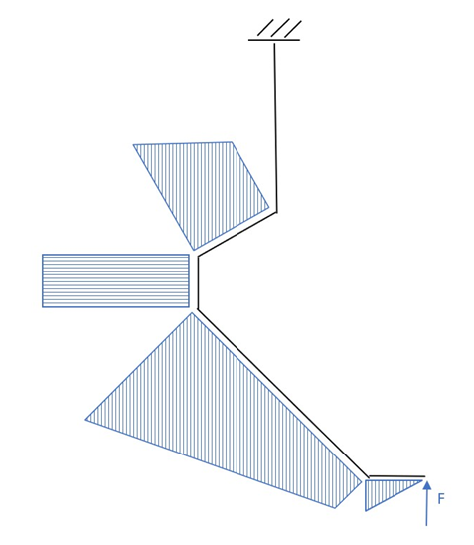
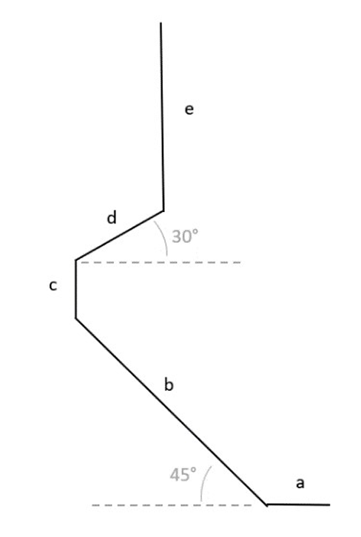
Static analysis

Slide 8
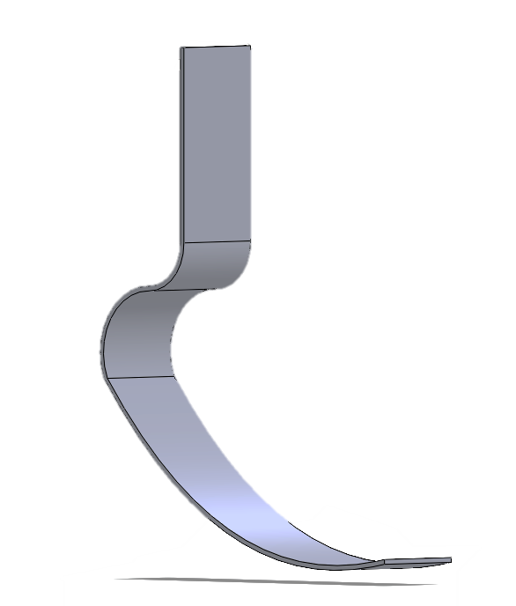
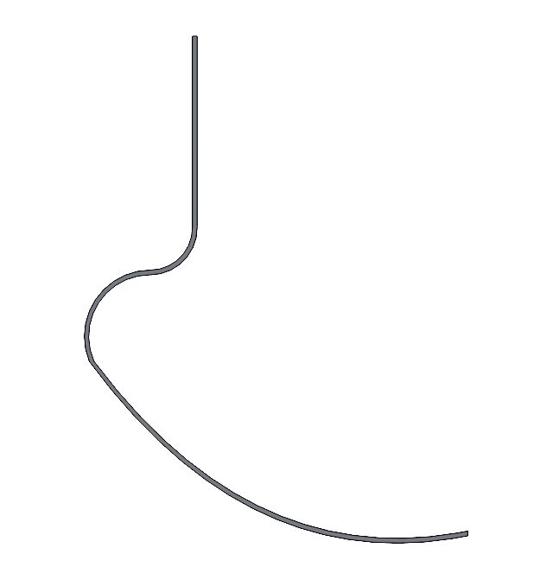

Model construction (1)

Slide 9
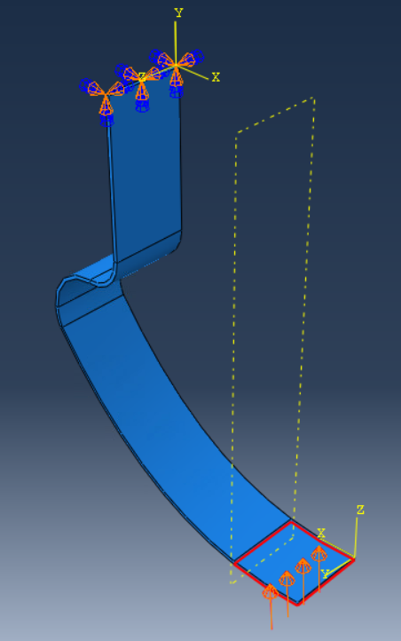
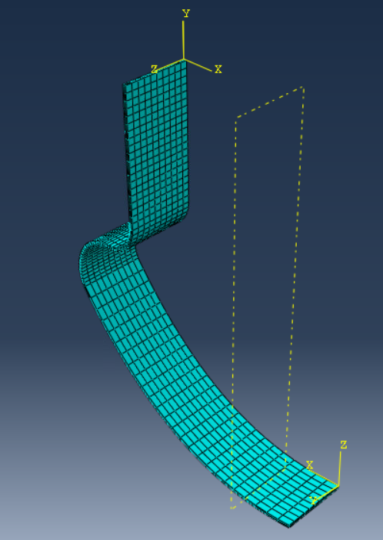
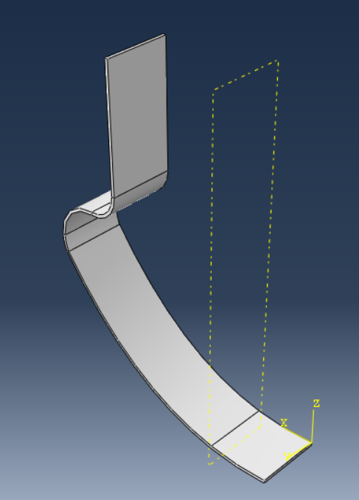

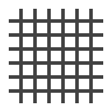
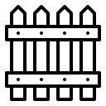

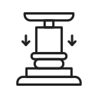
Model construction (2)
Material: lamina
Mesh: 2140 elements (S4R)
BCs: encastre
Load type: pressure

Slide 10
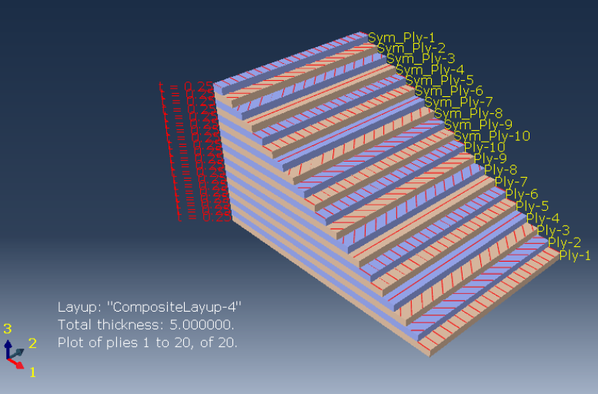
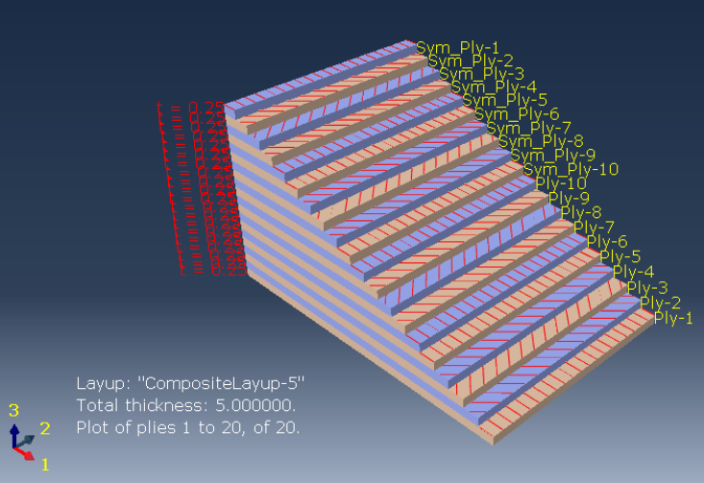
Composite layups; starting laminates
[0, 45, -45, 90, 0, 0, 90, -45, 45, 0]_{s}
[0, 45, -45, 45, 0, 0, 45, -45, 45, 0]_{s}

Slide 11
Composite layups: optimization pattern
[0, 45, -45, 90, *, 0, 0, 90, -45, 45, *, 0]_{s}
[0, 45, -45, 45, *, 0, 0, 45, -45, 45, * 0]_{s}
[45, 90]_{n} packets at *
[±45]_{n} packets at *
Tsai-Hill < 1
δ= 4 cm

Slide 12
Materials
CFRP
E₁ = 177 GPa
GFRP
E₁ = 43 GPa
Aluminium
E = 72 GPa
ρ = 1.6 ${g/cm}^{3}$
ρ = 1.6 〖𝑔/𝑐𝑚〗^3
ρ = 2 ${g/cm}^{3}$
ρ = 2 〖𝑔/𝑐𝑚〗^3
ρ = 2.8 ${g/cm}^{3}$
ρ = 2.8 〖𝑔/𝑐𝑚〗^3
E₂ = 10.8 GPa
E₂ = 8.9 GPa
𝜈 = 0.33
𝜈₁₂ = 0.27
𝜈₁₂ = 0.27
G₁₂ = 7.6 GPa
G₁₂ = 4.5 GPa

Slide 13
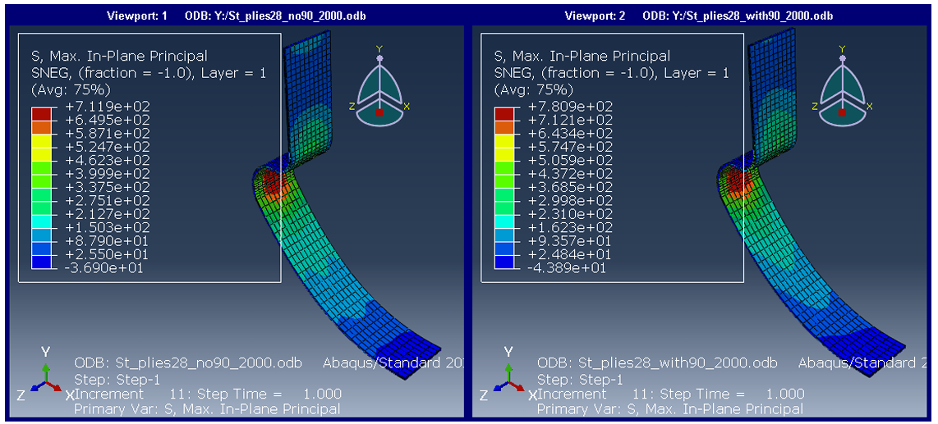
Results

Slide 14
Results
Objectives
Maximum displacement = 4 cm
Lowest possible weight
Stacking sequence

Slide 15
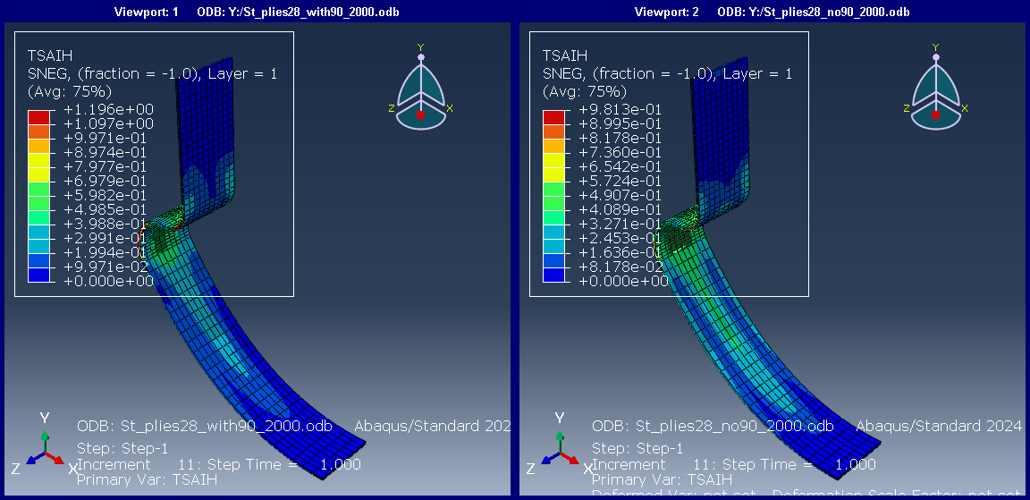

Results
Objectives
Maximum displacement = 4 cm
Lowest possible weight
Stacking sequence

Slide 16
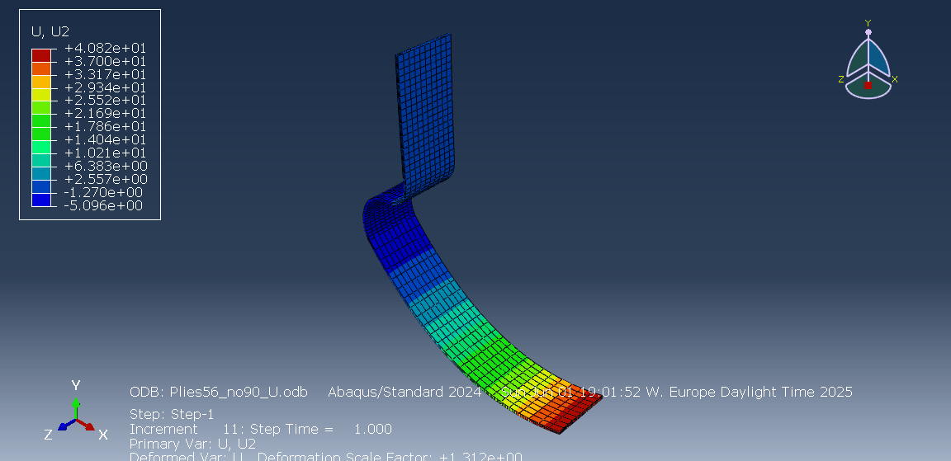
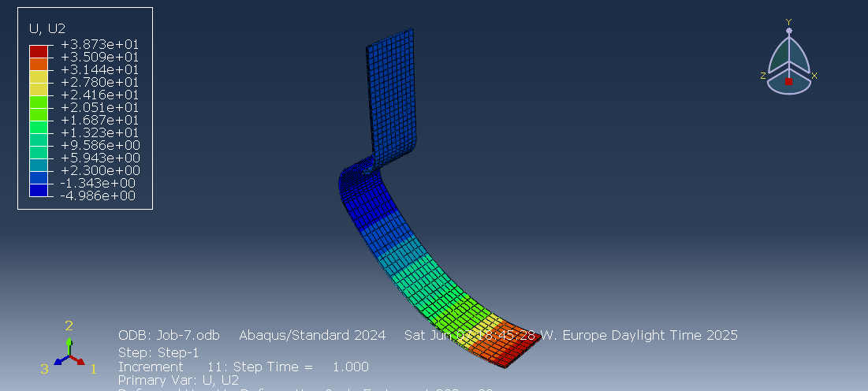
Results
Objectives
Maximum displacement = 4 cm
Lowest possible weight
Stacking sequence
CFRP
GFRP
52 plies
13 mm thickness
1.75 Kg
82 plies
20.5 mm thickness
3.5 Kg

Slide 17
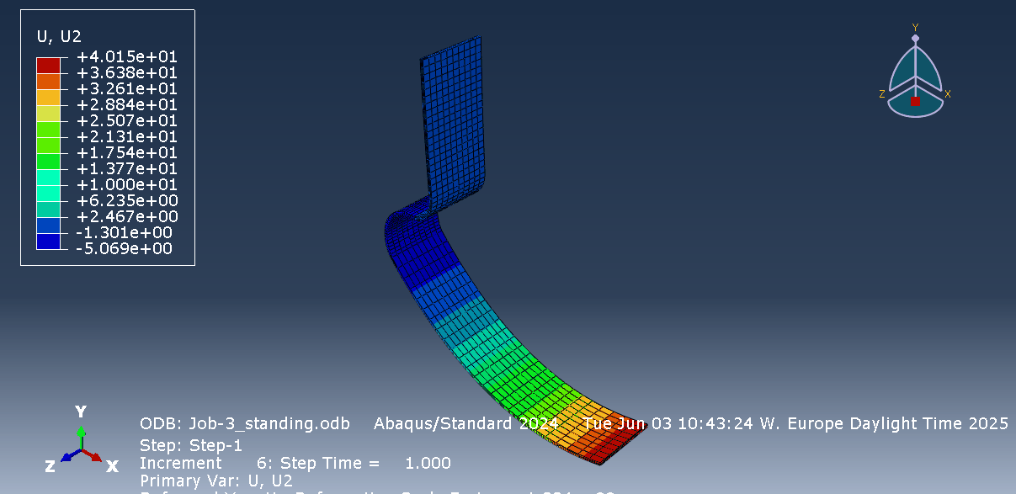

Results
Objectives
Maximum displacement = 4 cm
Lowest possible weight
Stacking sequence
Aluminum
12 mm thickness
2.8 Kg

Slide 18
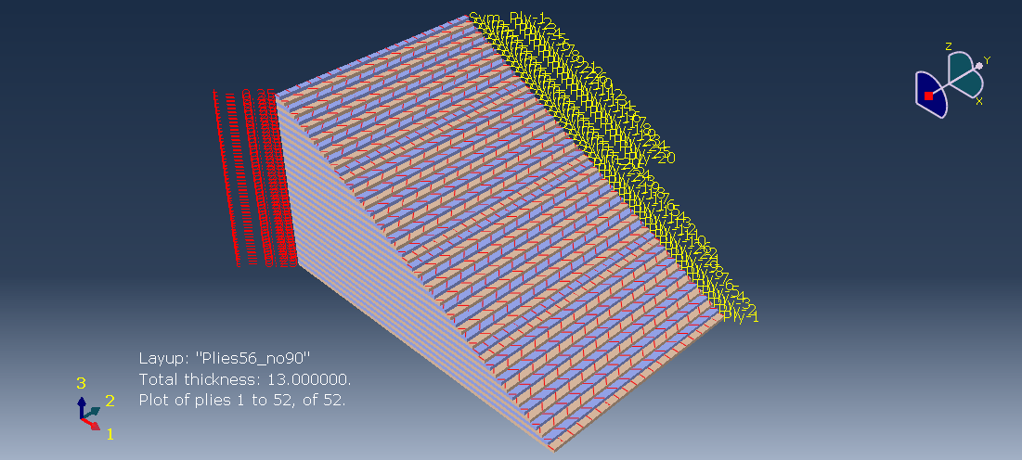

Results
Objectives
Maximum displacement = 4 cm
Lowest possible weight
Stacking sequence

Slide 19
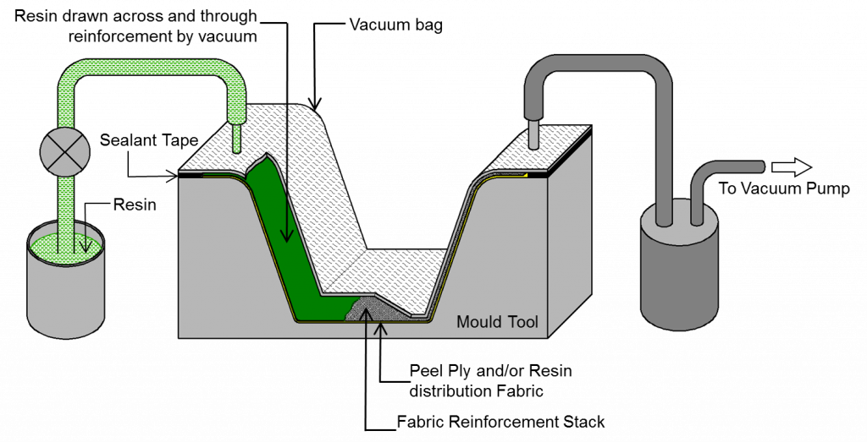

Manufacturing
Hand lay-up
Prepreg Vacuum Bagging
RTM
Cheap and simple process but subject to high variability and lower quality
Cheaper process with respect to RTM, still guranteeing high quality at lower costs
Fast process with high quality capability but the investment cost does not justify its use for running blades

Slide 20
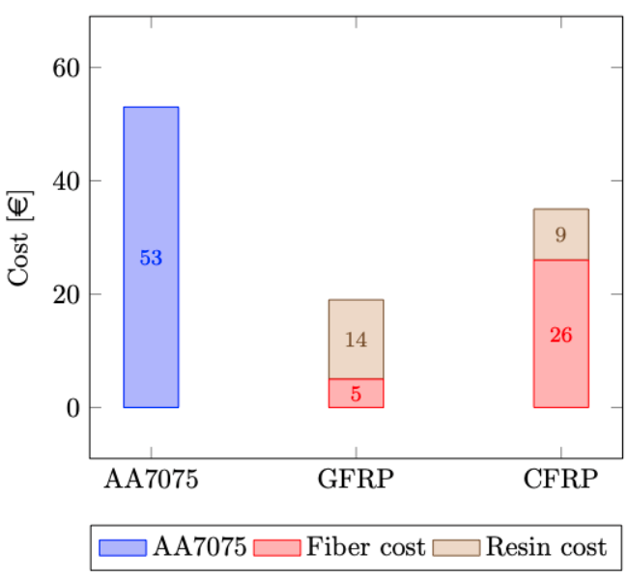
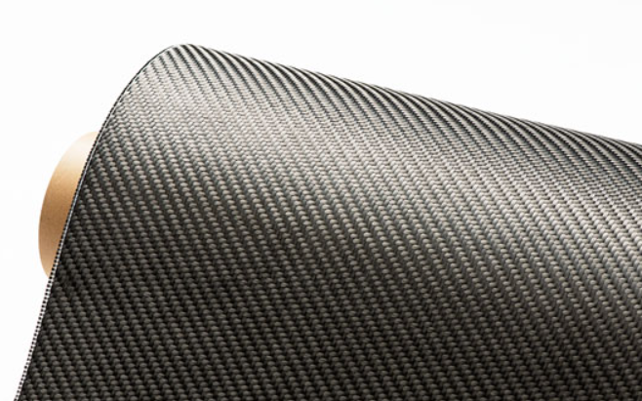
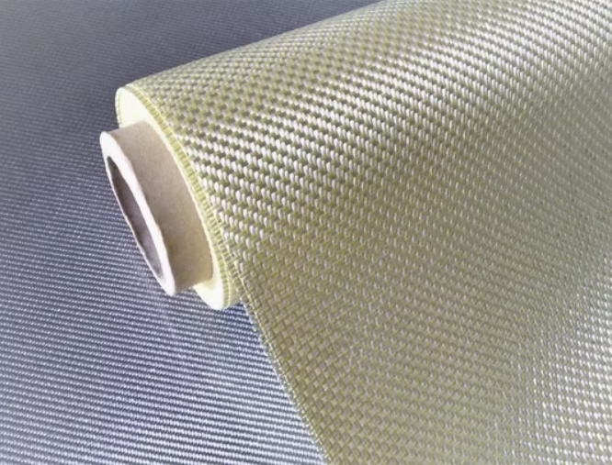
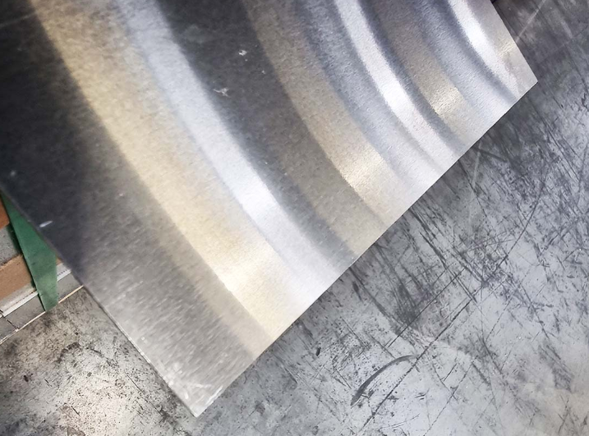
Cost evaluation: contributions
Raw materials
Post processing
Prepreg vacuum bagging
Personalization through optimization
Low production numbers
Metallic inserts
Certifications and brand name
No reference on the market for processes and brands

Slide 21
Cost evaluation: results
Raw materials
Mark-up
3-5x
R&D
Manufacturing
≅ 15000 €

Slide 22
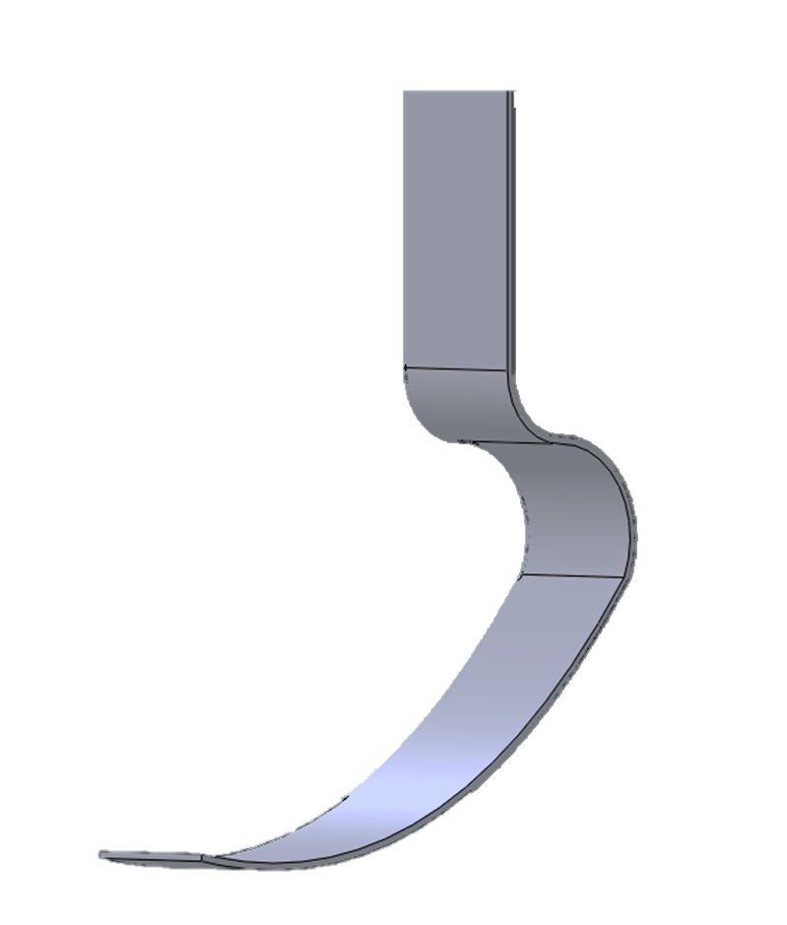



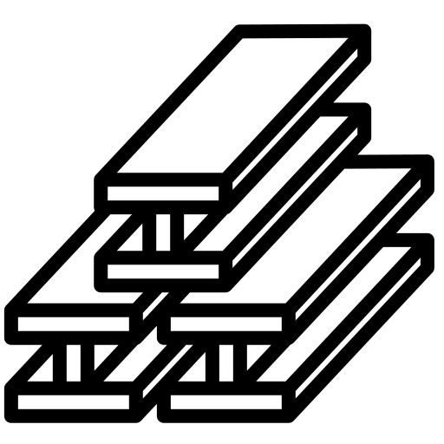

Conclusions
Geometry
Composite properties
Loads and BCs
Materials choice
Layup optimization

Slide 23
Thank you for your attention

